Slide 1


Big Data Analytics
NAVTTC Batch III

Slide 2
Basic Programming in Python
Week 01 – 02

Slide 3
Outline
Introduction
Python IDEs
First Program
Variables
Casting
User input

Slide 4
Introduction
Python is a high-level, general-purpose programming language.
It is an open-source, interpreted language.
It uses indentations to emphasize code readability.
It is used for:
  Web development
  Data analysis and machine learning
  Automation or scripting
  Software testing

Slide 5
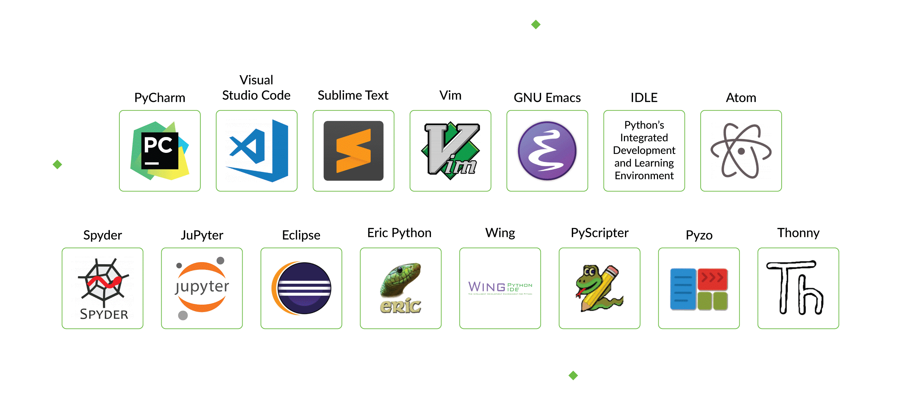
Python IDEs and Code Editors

Slide 6

First Python Program
The print() statement is used to print the given object to the terminal.
These two statements will print an imaginary dog on the terminal.
This statement will print 10 * on the terminal.
print("Hello world")

Slide 7
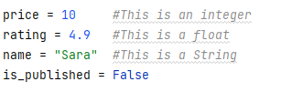
Variables
One of the most fundamental concepts in programming.
Variables are used to temporarily store data in a computer’s memory.
Creating Variable
  A variable is created the moment you first assign a value to it.
  Example

Slide 8
Task
Imagine you work in the university’s admission department. You have to enter the data for a student named Hamza Khan. He is 20 years old and he is a new student.

Slide 9
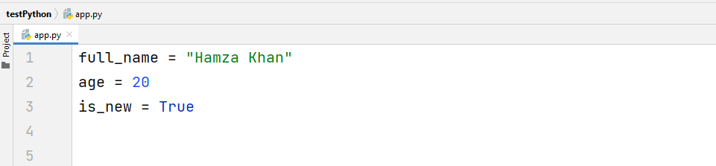
Task Solution

Slide 10
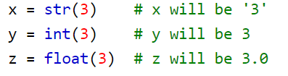
Casting
If you want to specify the data type of a variable, this can be done with casting.
Example

Slide 11
Getting User Input
Python provides us with an inbuilt function to read the input from the keyboard.
  input ( prompt )
input ( ): This function first takes the input from the user and then evaluates the expression, which means Python automatically identifies whether the user entered a string or a number or list. If the input provided is not correct then either syntax error or exception is raised by python. For example –
val = input("Enter your value: ")
print(val)

Slide 12
Task
Ask two questions from the user: the user’s name and their favorite sport.
Then print a message like, Ahmed likes football.

Slide 13
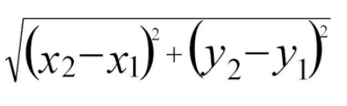
Task
Write a program to compute the distance between two points taking input from the user
Formula:
Write a program add.py that takes 2 numbers as command-line arguments and prints its sum

